Slide 1


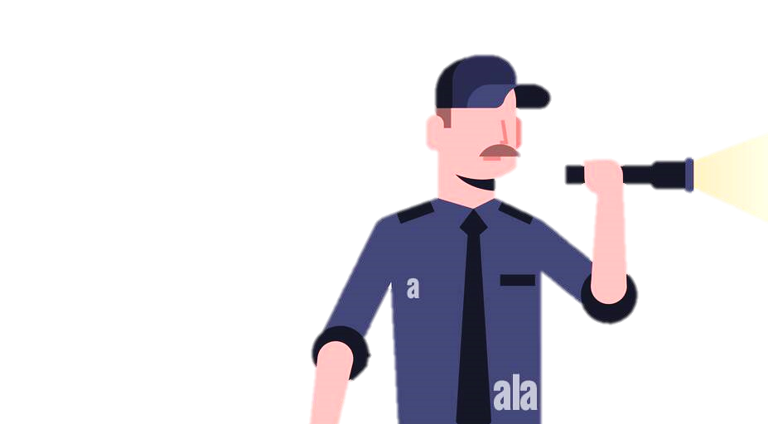
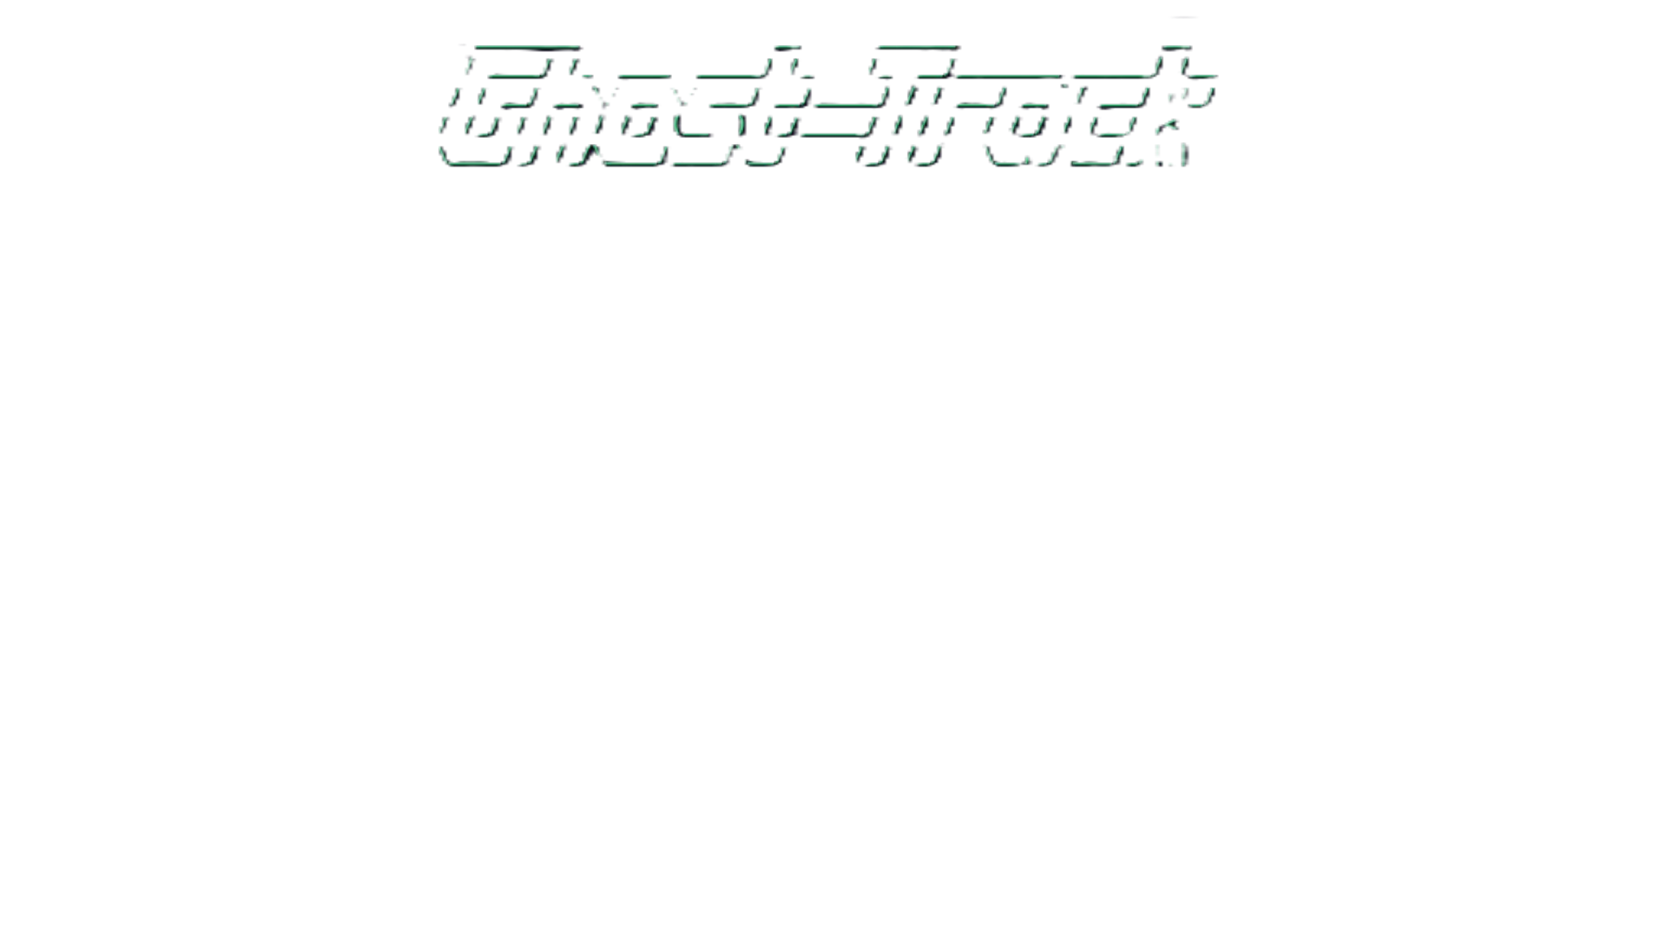

M2 Presentation
By: Taja Hicks, Luis Morales,
Abigail Rodriguez Vazquez

Slide 2

Three OSINT Tools
This presentation compares three GitHub-based OSINT tools used in cybersecurity, digital forensics, and threat intelligence:
by p1ngul1n0​
by HunxByts​
by thewhiteh4t​​

Slide 3
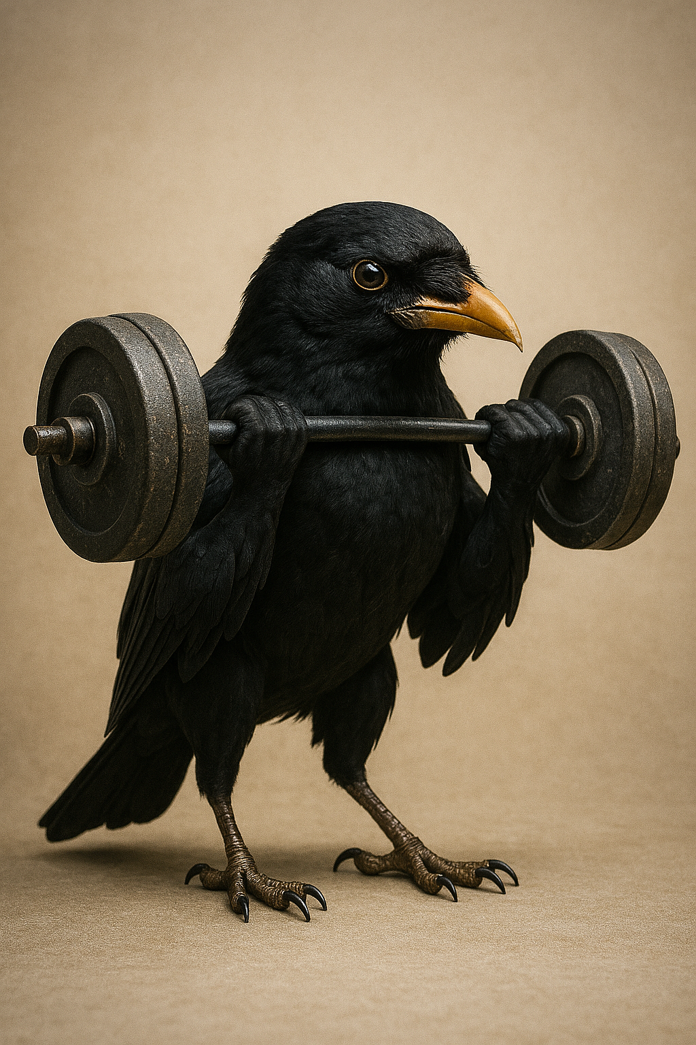
Strengths
Blackbird
Broad range of platforms (over 600)
AI integration and the option to choose whether you want to use it or not
Metadata Extraction
Multiple export options
Customizable filters

Slide 4
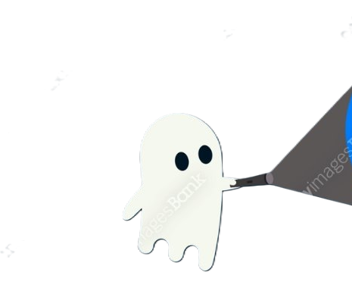
Ghost-Track Strengths
Can track location or mobile numbers
Gathers information including country or capital they live in
Can track username across sites

Slide 5

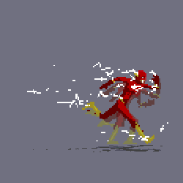
Nexfil Strengths
Fast lookups that can be completer under 20 seconds
Allows files containing usernames to be searched

Slide 6
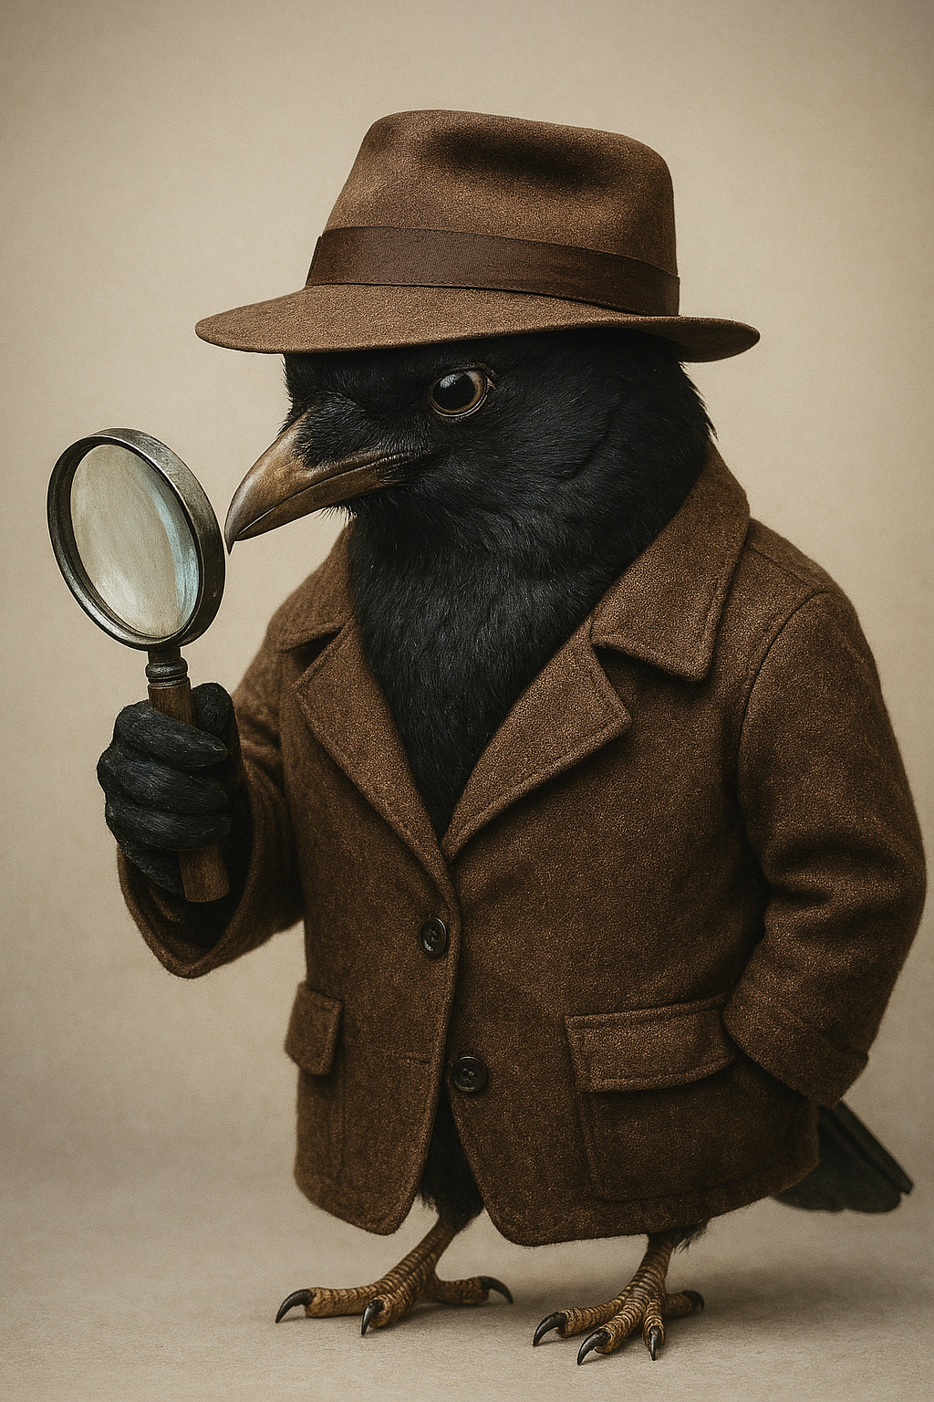
Weaknesses
Blackbird
Lookup time can be slower when searching more than 1 user/email
AI usage is limited to a number of searches each day

Slide 7

Weaknesses
Nexfil
Ghost-Track
Like Ghost-Track, small range of platforms (over 300) compared to Blackbird
Limited to saving results to txt file only
Limited features
Small range of platforms compared to Blackbird
IP geolocation can be imprecise or spoofed

Slide 8
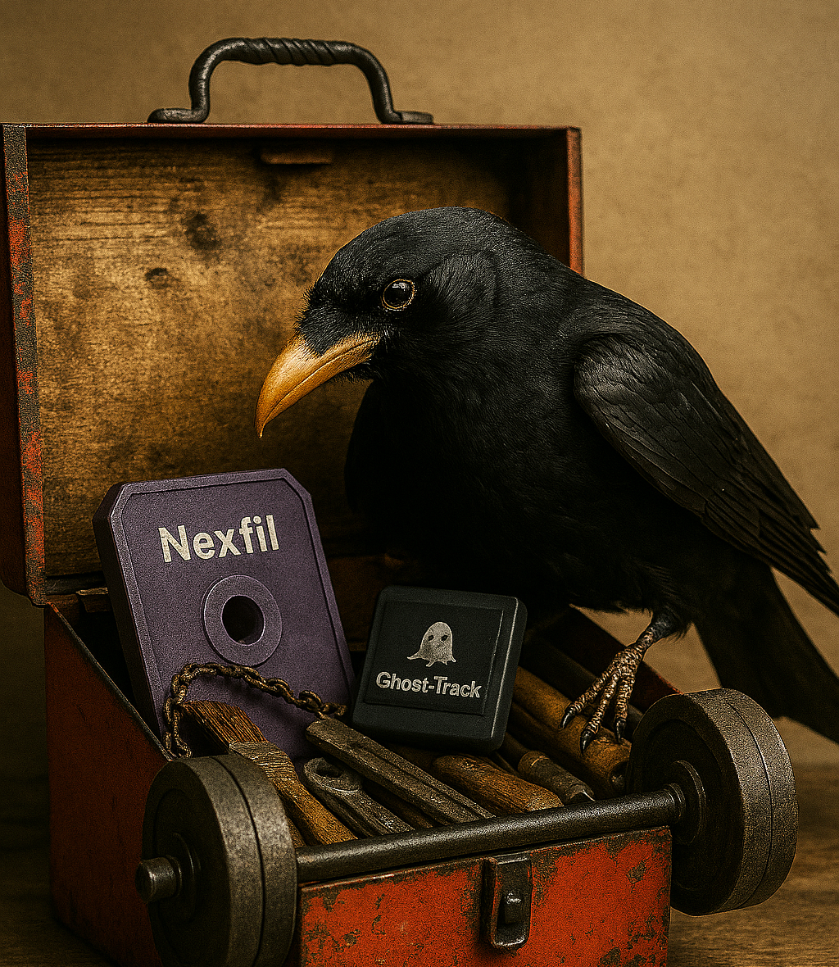
Choosing the Right Tool
Select a tool based on your OSINT goals:
Profiling -> Blackbird
Location tracking -> Ghost-Track
Fast username search -> Nexfil

Slide 9


Contribution
Our team chose the option
3.4 Conduct a study using the tool
Paper Topic: Privacy, Ethics and human-computer Interaction
We are thinking of conducting a study on how good blackbird is at connecting usernames/profiles
Then we will be measuring how much information is gathered.
Experiments for this study described further in report

Slide 10
Sources
[1] "Ghost Searching for Something with His Flashlight," iStock, 2019. [Online]. Available: https://media.istockphoto.com/id/929922340/vector/ghost-searching-for-something-with-his-flashlight-vector-illustration-concept.jpg?s=1024x1024&w=is&k=20&c=MkGwOUrPp_pAqlHSw4ICqPzMO5PJG7wFk2J9ChX6plo.
[2] "Security Guard Man in Black Uniform Holding Flashlight," Alamy, 2021. [Online]. Available: https://c8.alamy.com/comp/R8EXXX/security-guard-man-in-black-uniform-holding-flashlight-baton-police-officer-shining-flash-light-male-cartoon-character-full-length-flat-isolated-R8EXXX.jpg.
[3] "Toolbox Hand Tool," PNGKey, 2021. [Online]. Available: https://www.pngkey.com/png/full/332-3327509_toolbox-hand-tool-toy-tool-box-clip-art.png.

Slide 11
Sources
[4] "Flashlight Clipart," PinClipart, n.d. [Online]. Available: https://www.pinclipart.com/picdir/big/40-401408_flashlight-clipart.png.
[5] "Man Holding Flashlight," Iconfinder, n.d. [Online]. Available: https://cdn4.iconfinder.com/data/icons/men-holding/319/man-holding-017-512.png. [Accessed: 29-Oct-2025].
[6] "Raven Crow Silhouette Vector Set," Freepik, n.d. [Online]. Available: https://img.freepik.com/premium-vector/raven-crow-silhouette-vector-set-spooky-gothic-bird-clipart-halloween-dark-aesthetic_812921-3251.jpg?w=2000. [Accessed: 29-Oct-2025].

Slide 12
Sources
[7] "Flash," DeviantArt, 2015. [Online]. Available: https://orig00.deviantart.net/f404/f/2015/073/c/4/flash_by_z_studios-d8lo7eb.gif. [Accessed: 29-Oct-2025].

